Slide 1


Application of Python Programing in Twitter Mining
Team Members:
Makanjuola Ogunleye
Miracle Dickson
Course Instructor: Dr. Nicholson (Associate Professor)
Notes:
To change the image on this slide, select the picture and delete it. Then click the Pictures icon in the placeholder to insert your own image.

Slide 2

Introduction
Python programming language has become a mainstream language and its applications cuts across several industries including, Information Technology, Finance, Government, Market research and many others. In this research work, we would examine the application of Python in discovering information from text documents.

Slide 3
MOTIVATION
Our motivation is gotten from a Reality TV show competition in Nigeria called Big Brother Nigeria
This show has gathered public attraction and has generated a lot of controversies among Nigerians.
What makes this show popular is its eviction system, it requires the public to vote through Text message or an online voting platform.
Each contestant with the lowest vote during a voting period would be evicted.
The interesting thing is that most Nigerians now take to twitter to share their opinions and perception about their favorite contestant
Thus, tons of thousands of tweets are added daily mostly from Nigerians about this reality show.
We have extracted this data from twitter, analyzed them and checked for interesting information about them

Slide 4
DATA SET AND DATA COLLECTION
We took advantage of the fact that the show is currently ongoing, as a result we were able to gather tweets about the show using the hashtag #bbnaija
We connected to twitter using twitter streaming API and we have been able to gather 580,000 tweets
Attached is a link to our data( tweets) in a json format
https://goo.gl/WrMbt8

Slide 5
OBJECTIVES:
We have been able to answer the following research question at the end of the project:
How are tweeters distributed by location? We would like to know the locations with the most tweets, and general online social engagements in Nigeria
Who are the top contestant by popularity on twitter?
Number of tweets that contains each contestant?
Words with highest correlation with each contestant and generating N-grams?
Who are the Top tweeters and their location?
What are the sentiments around each contestant?
.

Slide 6
Data preprocessing – Twitter API
import tweepy
from tweepy import OAuthHandler
consumer_key = ‘************************************************'
consumer_secret = ‘**********************************************'
access_token = ‘**************************************************'
access_secret = ‘**************************************************'
auth = OAuthHandler(consumer_key, consumer_secret)
auth.set_access_token(access_token, access_secret)
api = tweepy.API(auth)

Slide 7
Data preprocessing – cont’d
def on_data(self, data):
try:
with open(‘Bnaija.json', 'a') as f:
f.write(data)
return True
except BaseException as e:
print("Error on_data: %s" % str(e))
return True

Slide 8
Data preprocessing – Data Cleaning
import nltk
from nltk.corpus import stopwords
stopwrd = set(stopwords.words('english'))
twtData['Tweet'] = twtData['Tweet'].apply(lambda x: x.lower())
twtData['Tweet'] = twtData['Tweet'].apply(lambda x: emoji_pattern.sub(r'', x))
twtData['Tweet'] = twtData['Tweet'].apply(lambda x: removeStopWord(x))
twtData['Tweet'] = twtData['Tweet'].apply(lambda x: removeUrl(x))
twtData['Tweet'] = twtData['Tweet'].apply(lambda x: replacePattern(x, 'cee'))
twtData['Tweet'] = twtData['Tweet'].apply(lambda x: replacePattern(x, 'mira'))

Slide 9
Research Question 1 – Distribution of tweets by location
locat = [i for i in location if i != None ]
lstDict= {}
for i in locat:
lstDict[i] = lstDict.get(i, 0) + 1
sortedlist = sorted(lstDict.items(), key=itemgetter(1), reverse =True)
sortedlist
lst2 = [j[0] for j in sortedlist[0:20][::-1]]
lst3 = [item for item in locat if item in lst2]plt.figure(figsize=(11,6))sns.countplot(y = lst3, order = lst2)
plt.savefig('ques1.jpg')

Slide 10
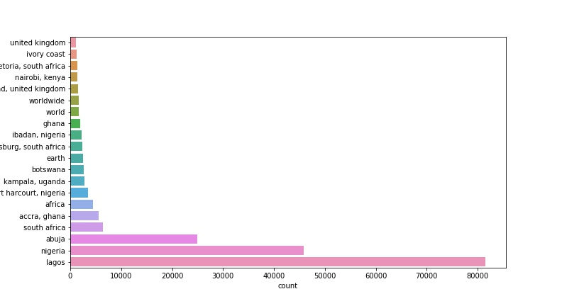
Research Question 1 – Distribution of tweets by location

Slide 11
Research Question 2 – Top contestant by popularity on twitter?
keys = ['mira', 'cee','alex', 'nina', 'lolu', 'khloe', 'tobi', 'anto’ ]
cnt = [countWrd(wordlst,x) for x in keys]
cntDict2 = dict(zip(keys,cnt))
sortedlist = sorted(cntDict2.items(), key=itemgetter(1), reverse = True)
sortedlistResult:
[('cee', 128625),
('mira', 128494),
('tobi', 125635),
('alex', 69863),
('nina', 59147),
('lolu', 50859),
('anto', 24681),
('khloe', 16389)]

Slide 12
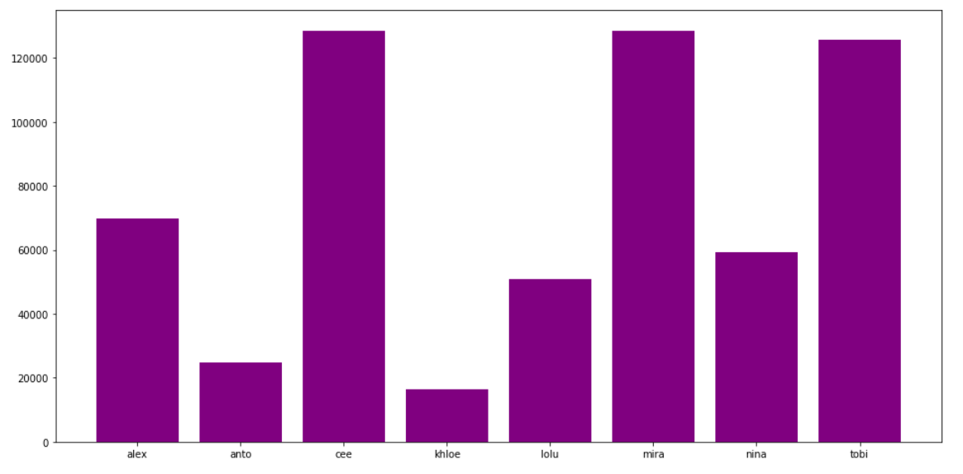
Research Question 2 – Top contestant by popularity on twitter?

Slide 13
Research Question 3 – Number of tweets that contains each contestant?
cnt = [countWrd(twtData['Tweet'],x) for x in keys]
cntDict1 = dict(zip(keys,cnt))
sortedlist = sorted(cntDict1.items(), key=itemgetter(1), reverse = True)
ax = plt.bar(keys, cnt)
plt.show()
sortedlistresult:
[('cee', 108143),
('mira', 103604),
('tobi', 95517),
('alex', 62336),
('nina', 51027),
('lolu', 40019),
('anto', 22519),
('khloe', 15559)]

Slide 14
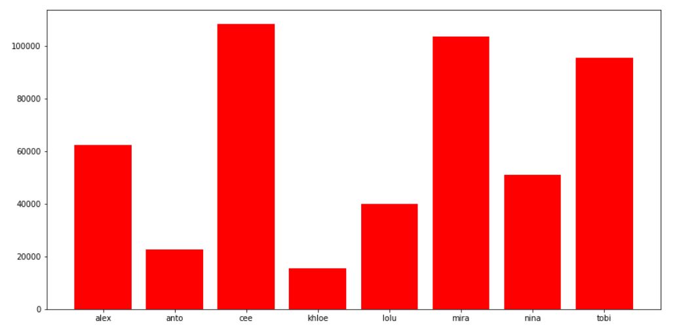
Research Question 3 – Number of tweets that contains each contestant?

Slide 15
Research Question 4 – Words with highest correlation with each contestant and generating N-grams?
def Ngram(data, keyword):
gramLst = []
for i in range(len(data)):
if data[i] == keyword :
if data[i-1] == data[i] or data[i] == data[i+1]:
continue

Slide 16
Research Question 4 – cont’d
elif data[i-1] == data[i+1]:
needOnly = data[i-1] + '-' + data[i]
gramLst.append(needOnly)
else:
needLeft = data[i-1] + '-' + data[i]
needRight = data[i] + '-' + data[i + 1]
gramLst.append(needLeft)
gramLst.append(needRight)
return gramLst

Slide 17
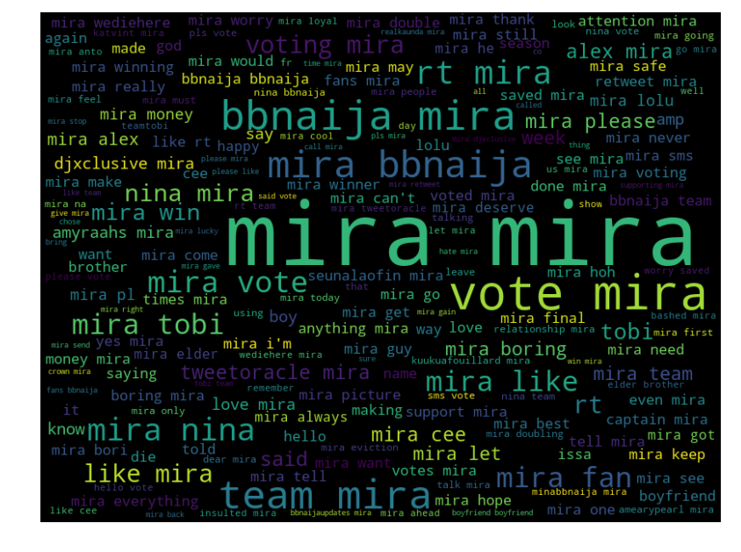
Research Question 4 – cont’d

Slide 18
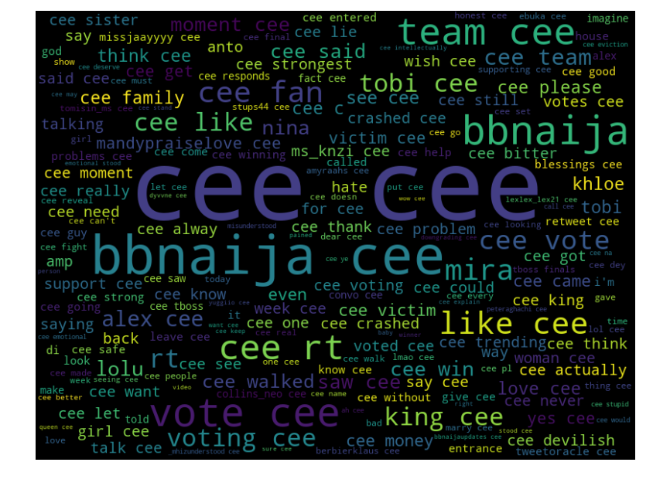
Research Question 4 – cont’d

Slide 19
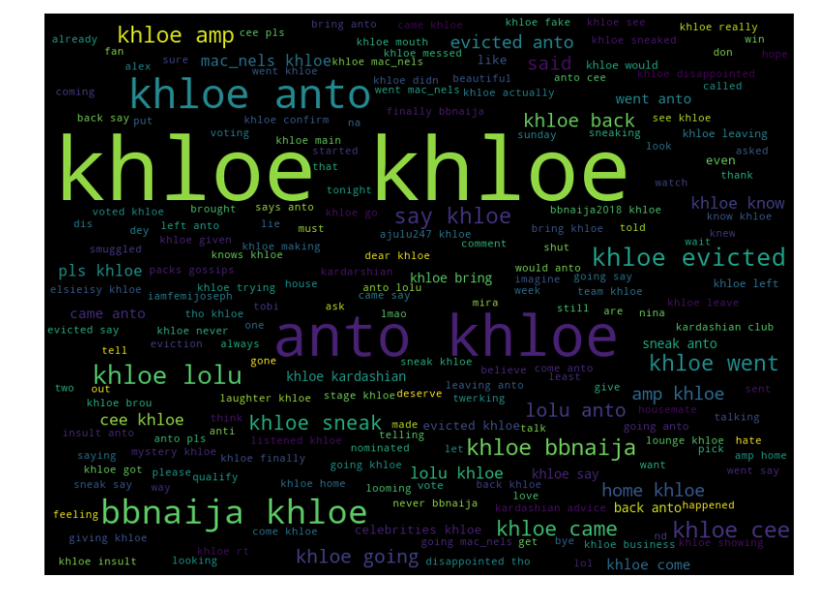
Research Question 4 – cont’d

Slide 20
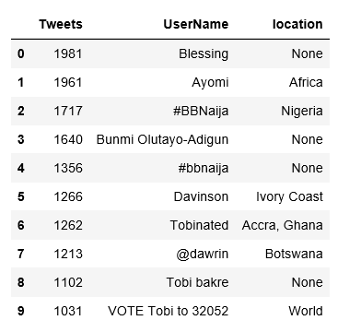
Research Question 6 – Who are the Top tweeters and their location?
TweeterD.loc[topTweeterD.index[:10]]

Slide 21
Research Question 7 – What are the sentiments on the entire text?
def get_tweet_sentiment(tweet):
analysis = TextBlob(tweet)
if analysis.sentiment.polarity > 0:
return 'positive'
elif analysis.sentiment.polarity == 0:
return 'neutral'
else:
return 'negative'
twtData['Sentiment'] = twtData['Tweet'].apply(lambda x: get_tweet_sentiment(x))

Slide 22
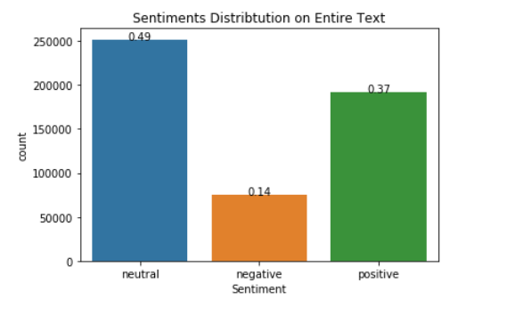
Research Question 7 – What are the sentiments on the entire text?

Slide 23
Research Question 7 – What are the sentiments on each contestant?
contExpr = [r'mira', r'cee', r'alex', r'nina', r'lolu', r'khloe', r'tobi', r'anto' ]
contId = [0,1,2,3,4,5,6,7]
contDict = dict(zip(contId,contExpr))
ContestantFrame = [twtData.loc[twtData['Tweet'].apply(lambda x: bool(re.search(contDict[item], x)))] for item in contId]
fig, ax =plt.subplots(2,2)
def subPlot(data, m, n, title):
sns.countplot(x="Sentiment", data=data, palette="muted", ax=ax[m][n]).set_title(title)
total = float(len(data))
for p in ax[m][n].patches:
height = p.get_height()
ax[m][n].text(p.get_x()+p.get_width()/2., height + 3, '{:1.2f}'.format(height/total), ha="center")
return plt.show()
subPlot(ContestantFrame[0],0,0,'Sentiments Around Miracle')

Slide 24
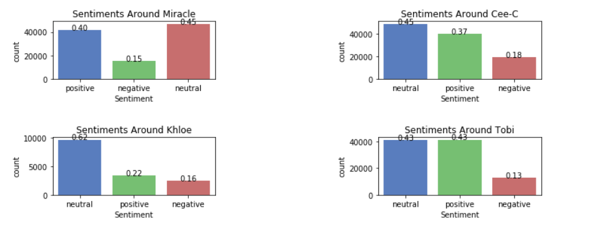
Research Question 7 – What are the sentiments on each contestant?

Slide 25
The End

Slide 26
Add a Slide Title - 1

Slide 27
Add a Slide Title - 2

Slide 28
Add a Slide Title - 3

Slide 29
Add a Slide Title - 4

Slide 31
Add a Slide Title - 5

Slide 32
Add a Slide Title - 6

Slide 33
Add a Slide Title - 7

